Slide 1
DISTANCE VECTOR ROUTING ALGORITHM

Slide 2
OBJECTIVE
To implement Distance vector algorithm to find suitable path for transmission

Slide 3
DISTANCE VECTOR ROUTING
Adaptive/Dynamic Algorithm,
Route decisions will change dynamically in msec.
Each Router maintains a table called “Vector”
Vector contains no.of. Hops & delays
Table has the best known distance for each router
Tables are updated by exchanging information with neighbours
The columns of table represent the directly attached neighbors whereas the rows represent all destinations in the network

Slide 4
DISTANCE VECTOR ROUTING
Each router knows the best distance to reach another router
Also known as Bellman Ford Algo
Each router’s table has one entry for one router
Each entry has two parts
Preferred outgoing line for each router
Estimated distance to destination router
Distance is basically considered by no.of hops

Slide 5
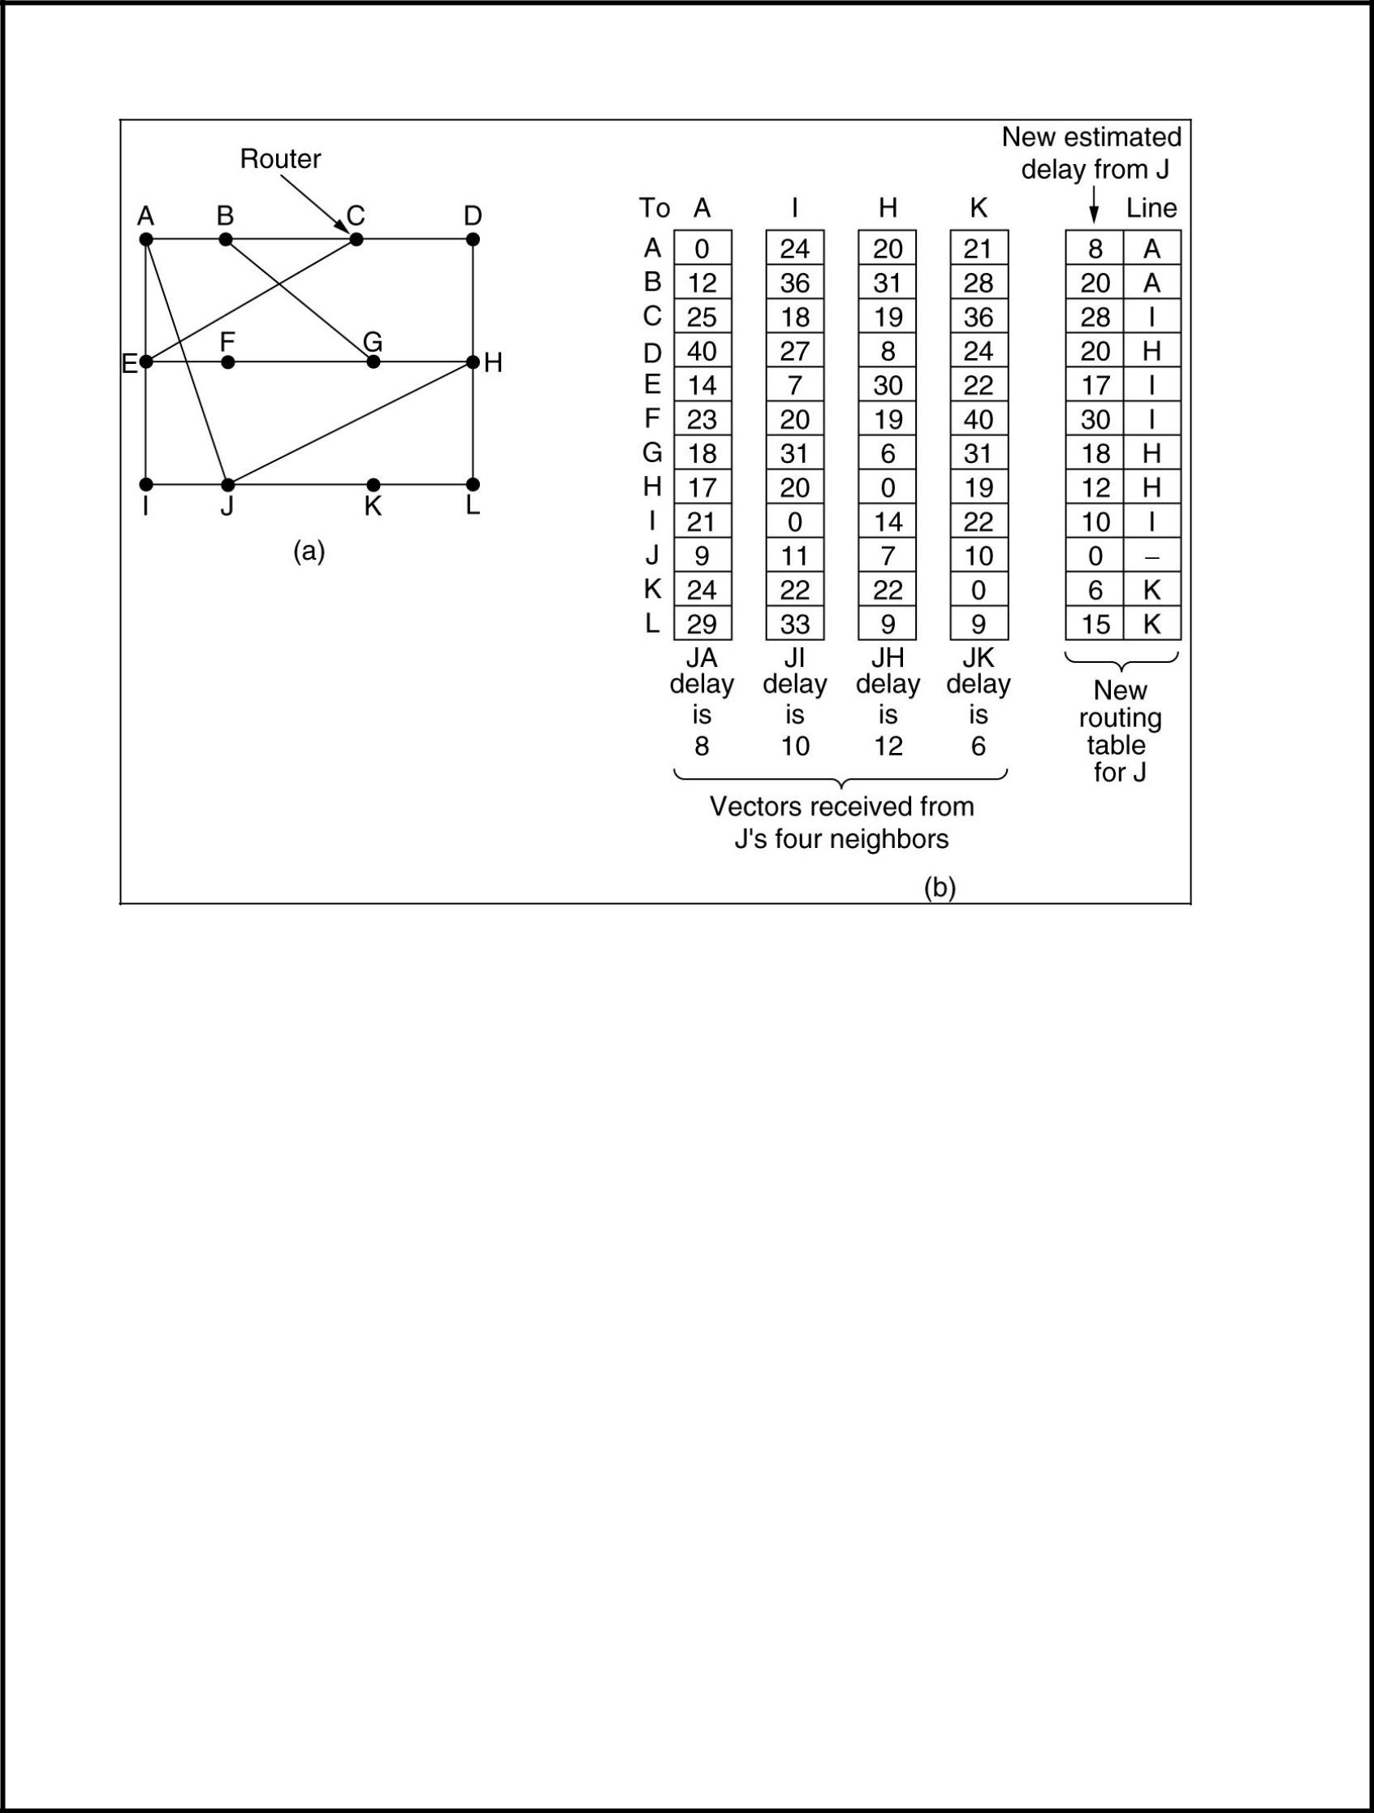

Slide 6
ALGORITHM
1. send my routing table to all my neighbors whenever my link table changes
2. when I get a routing table from a neighbor on port P with link metric M:
add L to each of the neighbor's metrics
b. for each entry (D, P', M') in the updated neighbor's table
i) if I do not have an entry for D, add (D, P, M') to my routing table
ii) if I have an entry for D with metric M", add (D, P, M') to my routing table if M' < M“
3. if my routing table has changed, send all the new entries to all my neighbors.

Slide 7
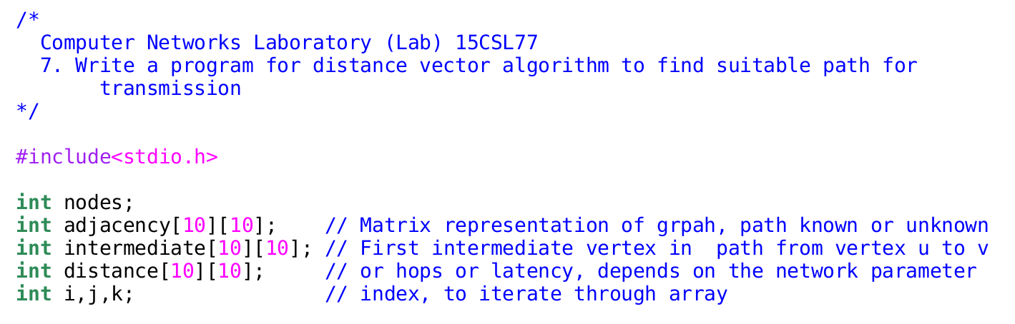
SOURCE CODE

Slide 8
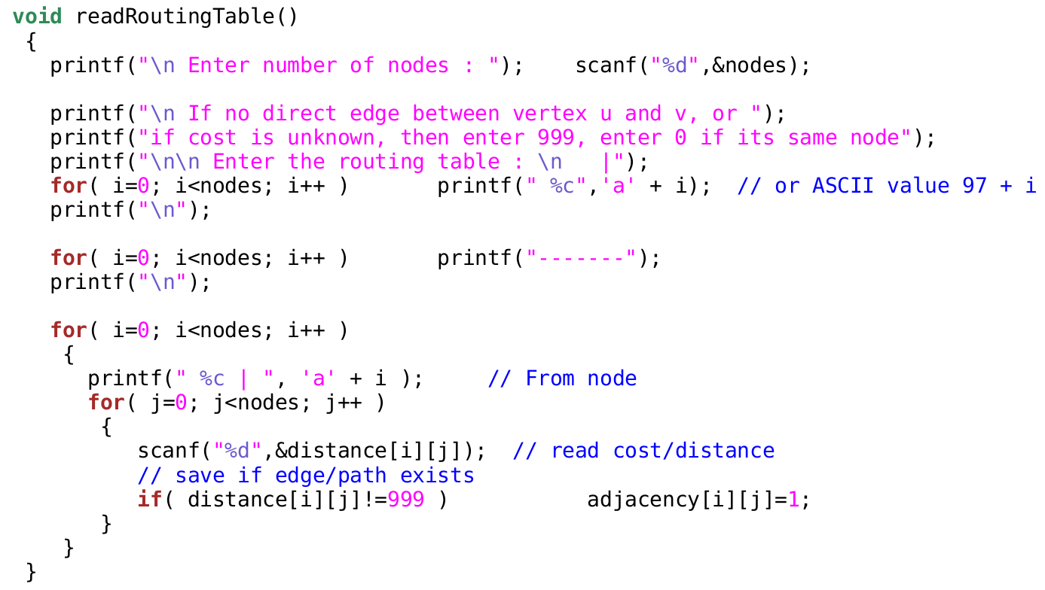

Slide 9
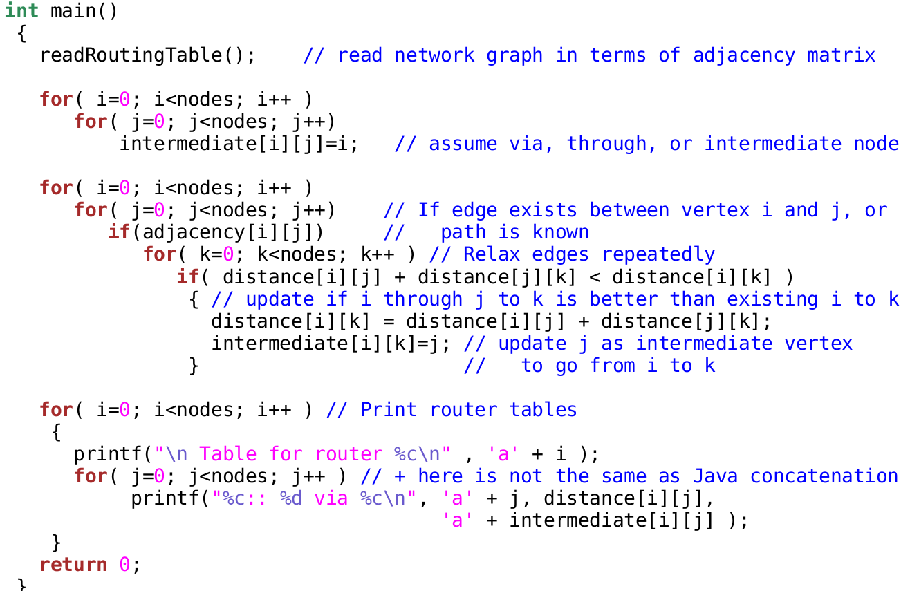

Slide 10
EXPECTED OUTPUT CASE:1
enter the value of no. of nodes
4
Enter the routing table :
|a b c d
----------------------------------
a |0 5 1 4
b |5 0 6 2
c |1 6 0 3
d |4 2 3 0

Slide 11
EXPECTED OUTPUT
table for router a
a:: 0 via a
b:: 5 via a
c:: 1 via a
d:: 4 via a
table for router b
a:: 5 via b
b:: 0 via b
c:: 5 via d
d:: 2 via b

Slide 12
EXPECTED OUTPUT
table for router c
a:: 1 via c
b:: 5 via d
c:: 0 via c
d:: 3 via c
table for router d
a:: 4 via d
b:: 2 via d
c:: 3 via d
d:: 0 via d

Slide 13
EXPECTED OUTPUT
do you want to change the cost(1/0)
1
enter the vertices which you want to change the cost
1 3
enter the cost
2
table for router a
a:: 0 via a
b:: 5 via a
c:: 2 via a
d:: 4 via a
table for router b
a:: 5 via b
b:: 0 via b
c:: 5 via d
d:: 2 via b

Slide 14
EXPECTED OUTPUT
table for router c
a:: 2 via c
b:: 5 via d
c:: 0 via c
d:: 3 via c
table for router d
a:: 4 via d
b:: 2 via b
c:: 3 via d
d:: 0 via d
do you want to change the cost(1/0)
0

Slide 15
EXPECTED OUTCOME
Students will be able to implement Distance vector Routing Algorithm.

